Slide 1

Cyber Minutes Weekly
"Attacks on the rise"
11-1-2023 | Jonathan Montoya

Slide 2

Confluence Data Center Privilege Escalation
CVE-2023-22515
Assigner: Atlassian
Published: 2023-10-04 Updated: 2023-10-20
Atlassian has been made aware of an issue reported by a handful of customers where external attackers may have exploited a previously unknown vulnerability in publicly accessible Confluence Data Center and Server instances to create unauthorized Confluence administrator accounts and access Confluence instances. Atlassian Cloud sites are not affected by this vulnerability. If your Confluence site is accessed via an atlassian.net domain, it is hosted by Atlassian and is not vulnerable to this issue. - CVE.org
Critical CVSS 10
Able to be executed in under 30 seconds

Slide 3
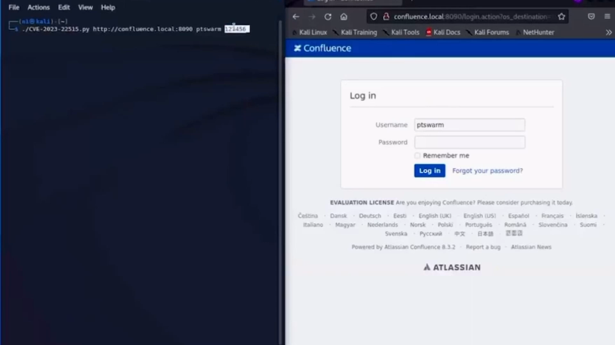

Slide 4

Ransomware on a tear
514 Attacks worldwide in September
Estimated 50-500M in payments
Major companies hit including MGM, Casio, Johnson Controls, Sony, etc.
"Dark Corporations" like EvilCorp, Clop, Dark Angels Team, and many more.

Slide 5

#Owned
Galaxy S23 hacked twice on the first day of Toronto event
Tesla Model 3 fully compromised in March
Prize pools worth over 1M

Slide 6
Sources
https://www.bleepingcomputer.com/news/security/september-was-a-record-month-for-ransomware-attacks-in-2023/
https://packetstormsecurity.com/files/175225/Atlassian-Confluence-Unauthenticated-Remote-Code-Execution.html
https://confluence.atlassian.com/security/cve-2023-22515-privilege-escalation-vulnerability-in-confluence-data-center-and-server-1295682276.html
https://www.bleepingcomputer.com/news/security/samsung-galaxy-s23-hacked-twice-on-first-day-of-pwn2own-toronto/
https://socradar.io/cve-2023-22515-the-confluence-data-center-and-server-vulnerability/
https://www.bleepingcomputer.com/news/security/sony-confirms-data-breach-impacting-thousands-in-the-us/
https://www.bleepingcomputer.com/news/security/building-automation-giant-johnson-controls-hit-by-ransomware-attack/
https://securityaffairs.com/144001/hacking/pwn2own-vancouver-2023-results.html

